Slide 1



Data science final project - NLP: Fake & Real news classification
Cecilia Moskovitch & Irena Shtelman Kravitz
NOV 2020
Notes:
שלום לכולם
אנחנו מציגות היום פרויקט בתחום NLP
נושא הפרויקט: Fake & Real news classification
מגישות הפרויקט: ססיליה ואירנה.

Slide 2
The problem and the data
Fake news became a common term during the past few years.
What is fake news? https://en.wikipedia.org/wiki/Fake_news
The objective of this project is to build a classifier that can predict whether a piece of news is fake based on its content, by using several different NLP models.
The data used for this project was drawn from Kaggle datasets.
https://www.kaggle.com/clmentbisaillon/fake-and-real-news-dataset
There are two different files, one for real news (~ 21.5K samples) and one for fake news (~ 23.5K samples).
Each file contains the following 4 features: Title, Text , Subject & Date
Notes:
אירנה
FAKE NEWS (WIKI):
מידע כוזב או מטעה המוצג כחדשות , ומועברים Formats שונים כגון : תקשורת מדוברת, כתובה, מודפסת, אלקטרונית ודיגיטלית
המטרתה של FN – היא לפגוע במוניטין של אדם או ישות, OR להרוויח כסף באמצעות הכנסות מפרסום.

Slide 3
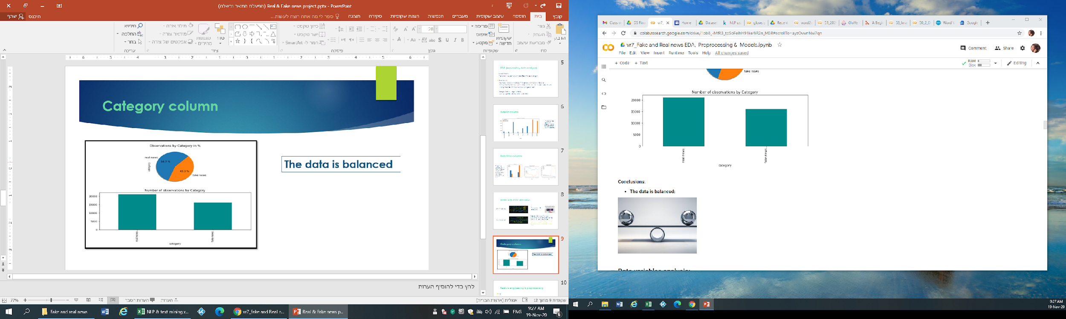
Initial EDA (exploratory data analysis) and visualizations
Features analysis:
Category feature – target variable -- > The data is balanced
Date column
Subject column
Text & title columns
Use only samples from mutual time frame for real & fake news (2016 – 2017)
Remove:
Rows with wrong data in date column
Rows with only white- space characters in “text” or “title” columns
Duplicated samples
“Subject” & “date” columns
Merge “title” & “text” columns
Notes:
אירנה
לאחר איחוד שני הדטה סטס היו כ- 45,000 שורות. הדטה סט של fake הכיל מידע מ-2015 עד 2018 והדטה סט של real הכיל מידע רק עבור 2016- 2017 - החלטנו להשאיר רק את השנים 2016-2017 עבור כל החדשות. במהלך בדיקת עמודת subject גילינו כי יש כפילויות – שורות זהות שויכו ל-subjects שונים וכמו כן סוגי ה-subject היו שונים –real וב-fake ולכן החלטנו להוריד את העמודה כיוון שהיא יוצרת הפרדה מוחלטת בין real ו-fake.
לאחר סיום ניקיון הדטה נותרו כ-37,500 שורות. כמו כן, הוספנו את עמודת ה-category, בדקנו כי הדטה סט מאוזן ולסיום עשינו shuffle של הדטה.

Slide 4
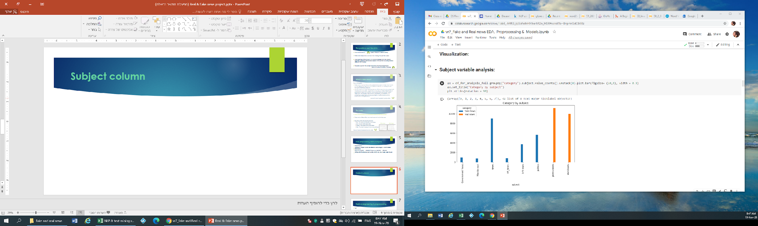
Subject column
4,744 duplicated samples (all data was the same, but subject was different).
The topics in "subject" column are different for each category.
“subject” column should be deleted
Notes:
אירנה

Slide 5
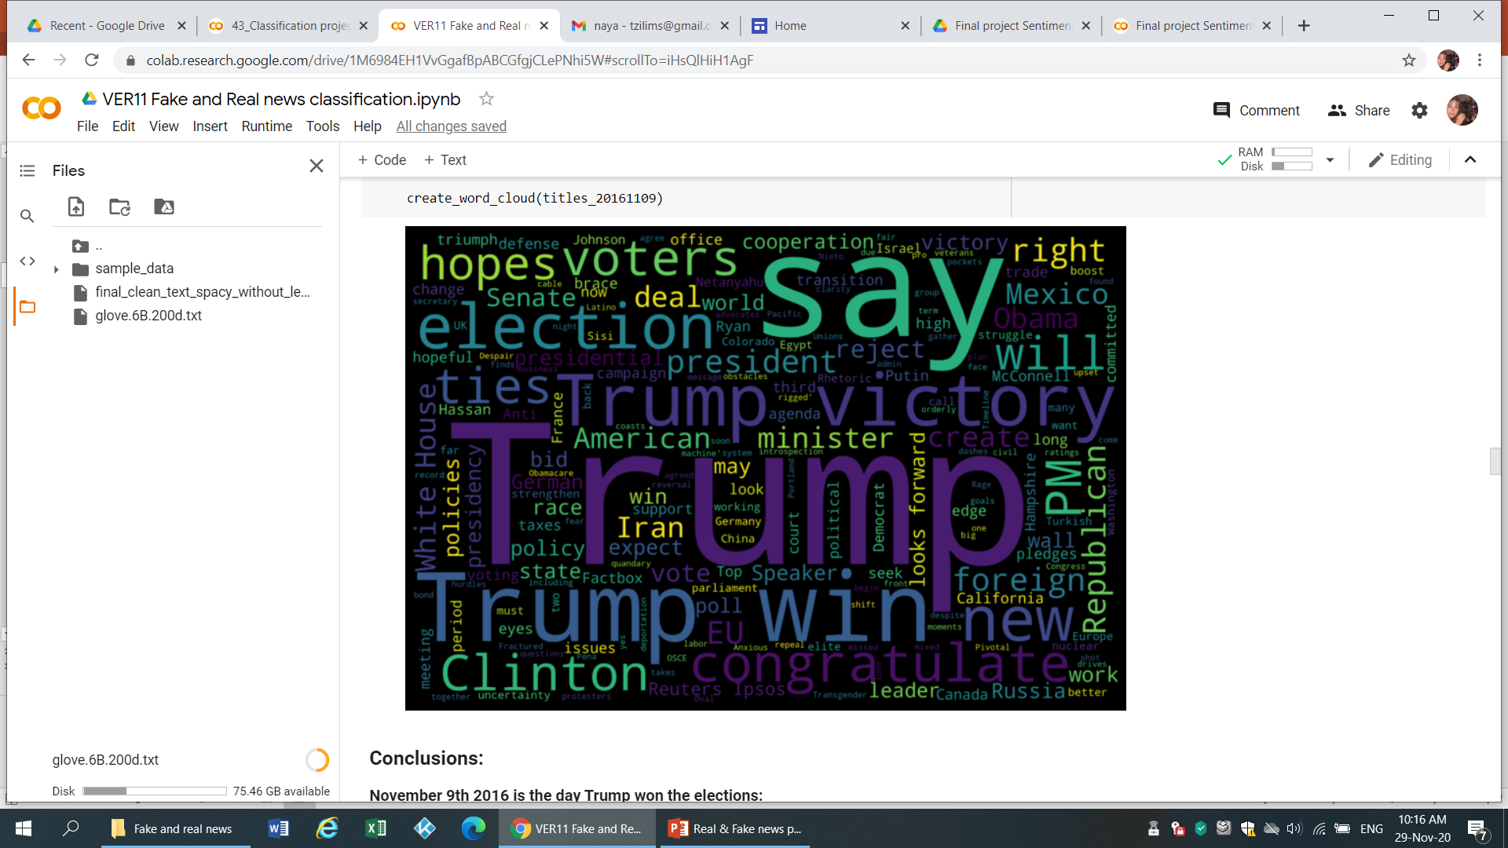
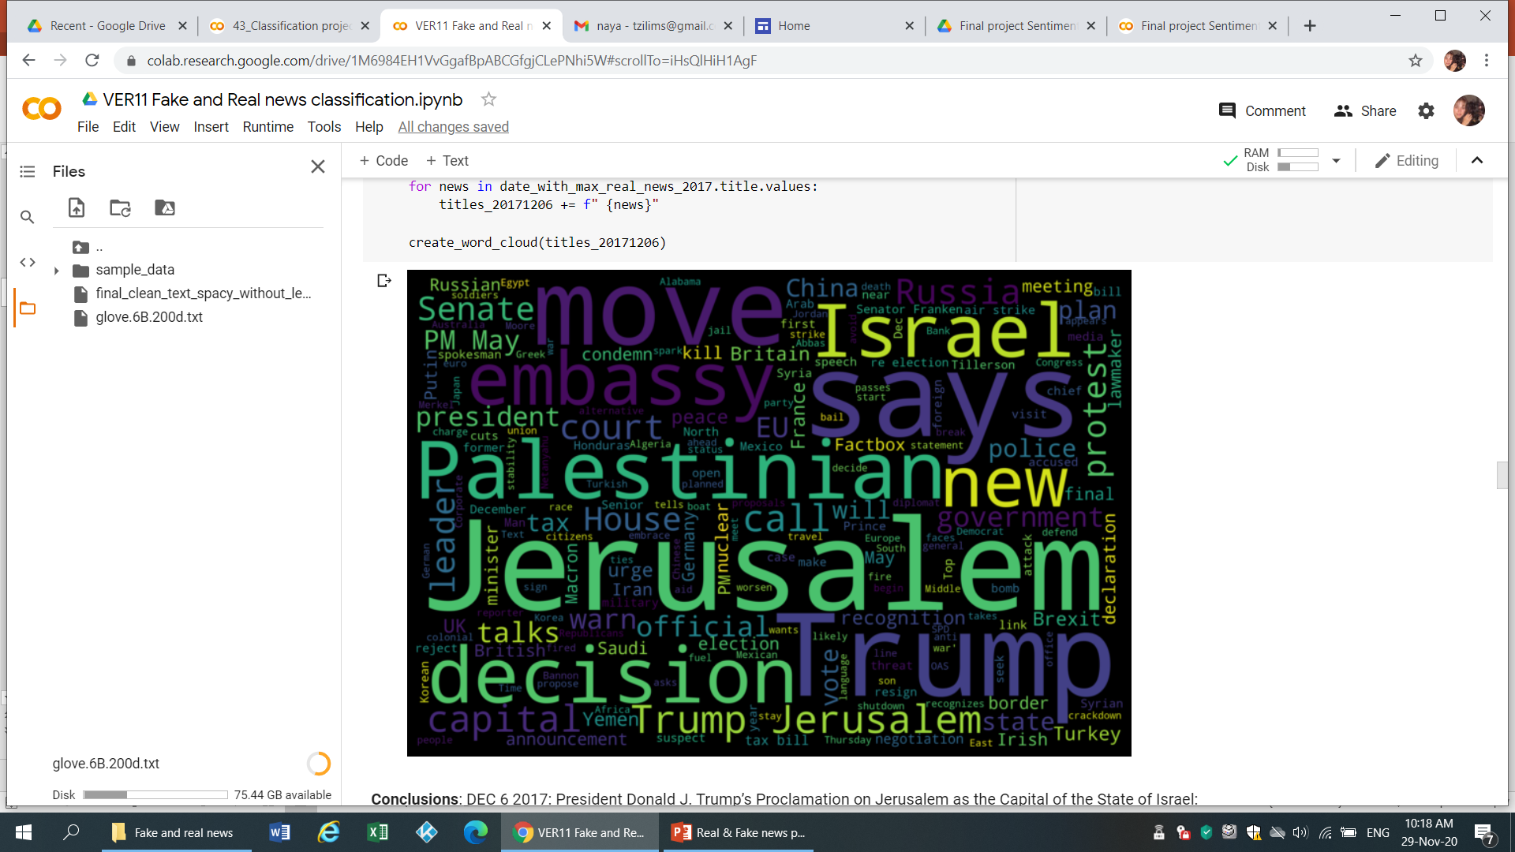
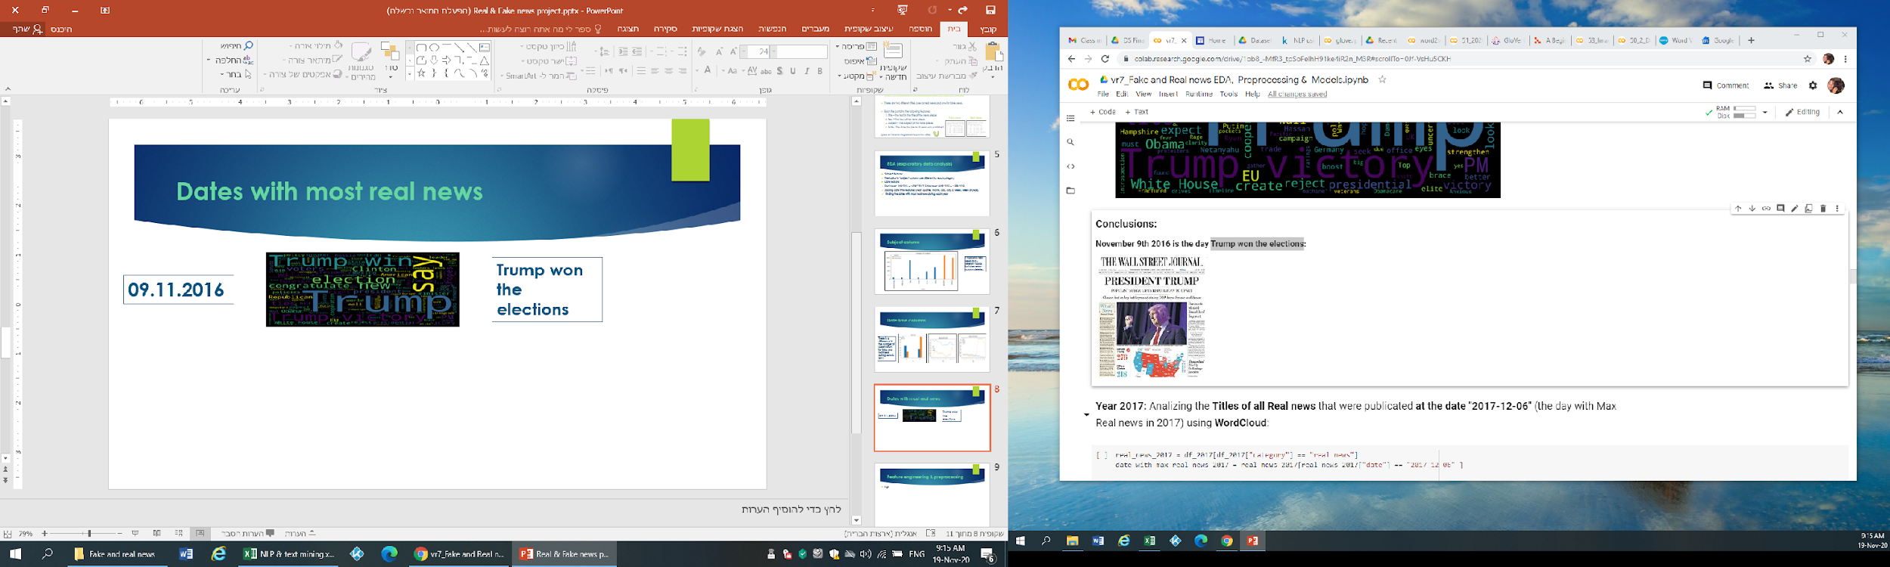
Analysis of dates with most real news
NOV 9th 2016
DEC 6th 2017
https://www.whitehouse.gov/briefings-statements/president-donald-j-trumps-proclamation-jerusalem-capital-state-israel/
Notes:
אירנה

Slide 6
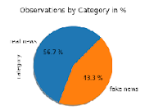
Preprocessing - data cleaning with spaCy, feature engineering, additional EDA & visualizations
Features engineering:
Add special marks - "quoteorterm“, "quotelink“, "username“ & "emoticons“
Data cleaning with spaCy:
token.is_stop is False
token.is_punct is False
token.is_space is False
token.is_bracket is False
Text analysis:
Word clouds & N - grams
Number of words in text -- > outlier detection
Number of characters in text & Average word length in text
Additional analysis with spaCy – Named Entities
token.is_quote is False
token.is_alpha is True
token.like_url is False
len(token) > 1
For DF with lemmatization:
token.lemma_.lower()
For DF without lemmatization:
token.lower_
Samples:
Before cleaning ~ 45K
After cleaning ~ 36.5K
Notes:
1- אירנה
2+3 – ססיליה
4 - אירנה

Slide 7
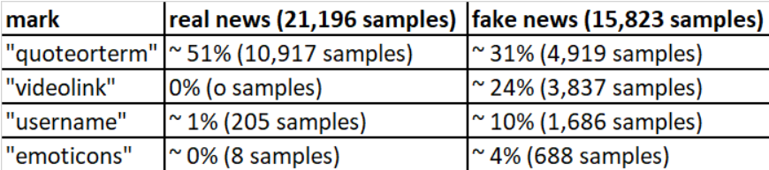
Special marks
Notes:
אירנה

Slide 8

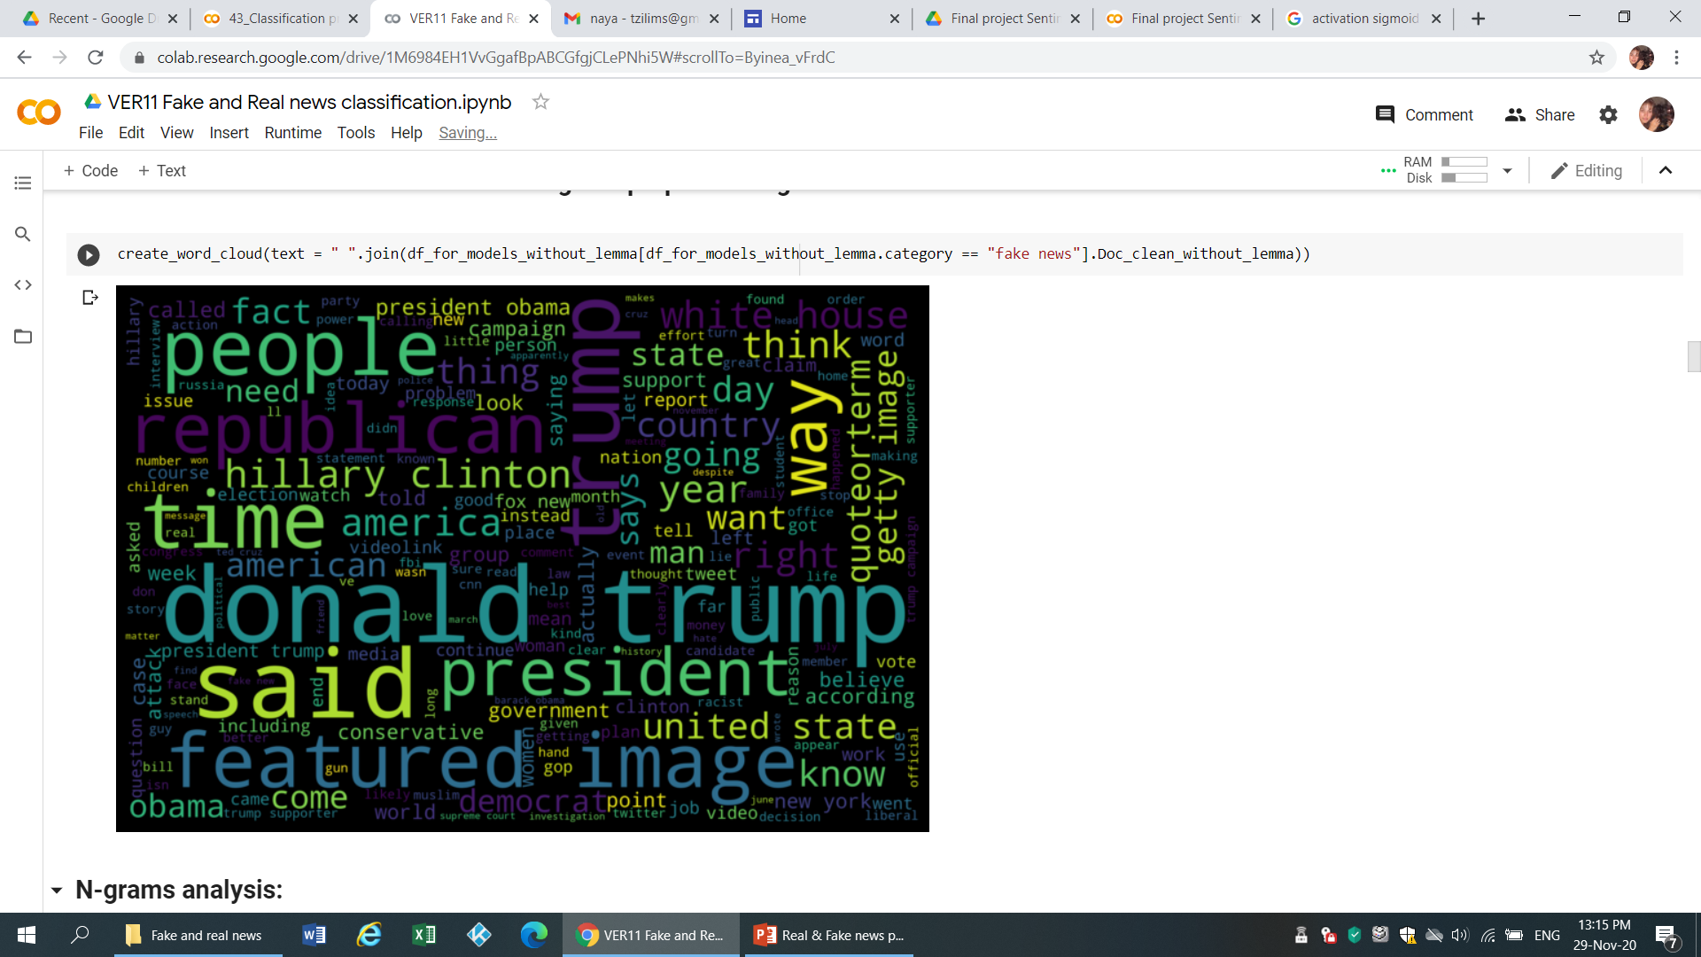
Word clouds after data cleaning and preprocessing
Real news
Fake news
Notes:
ססיליה

Slide 9
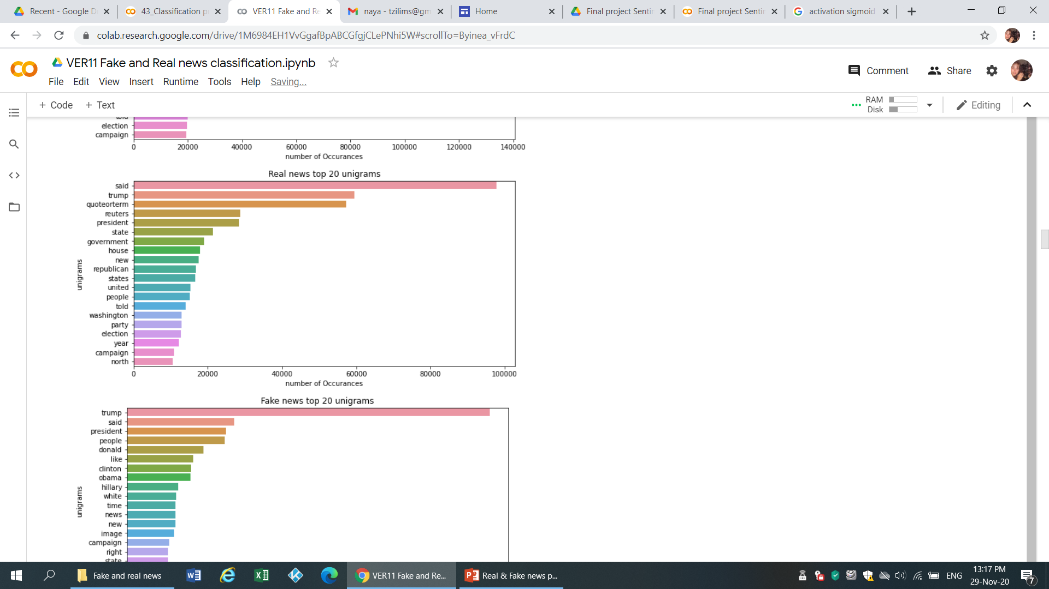
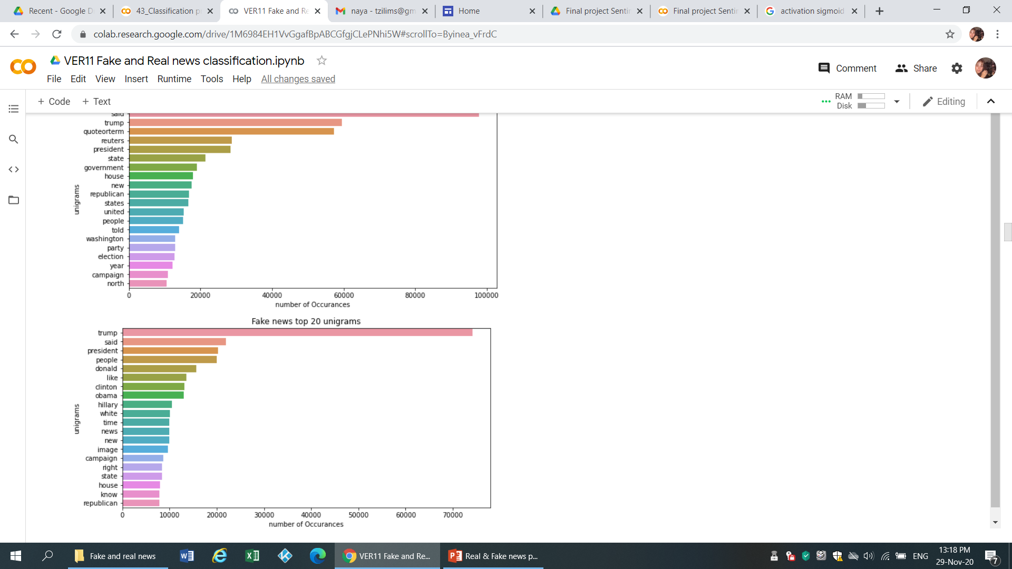
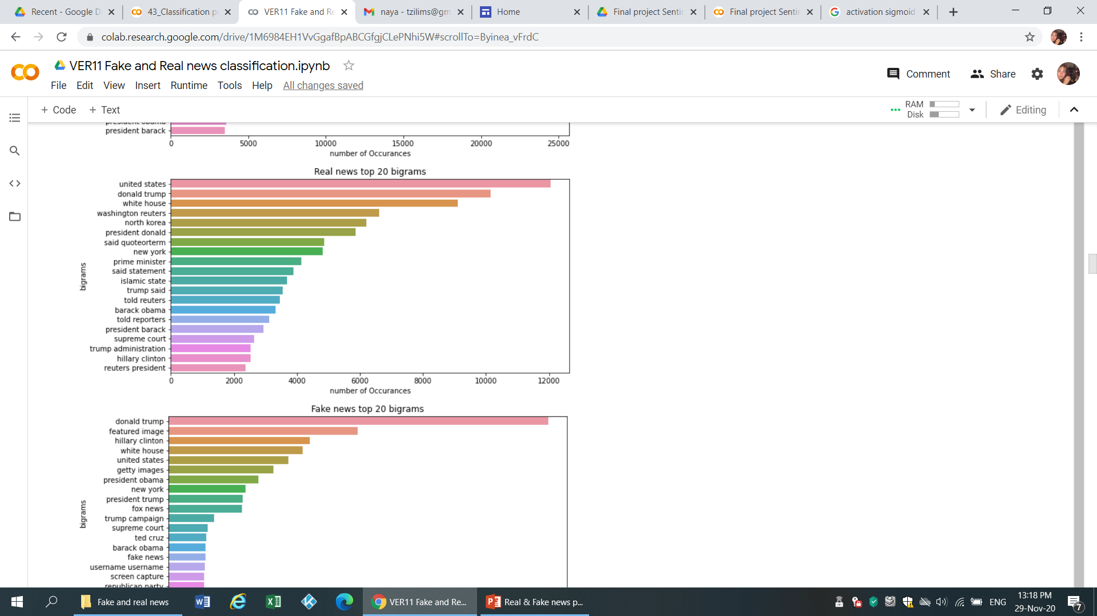
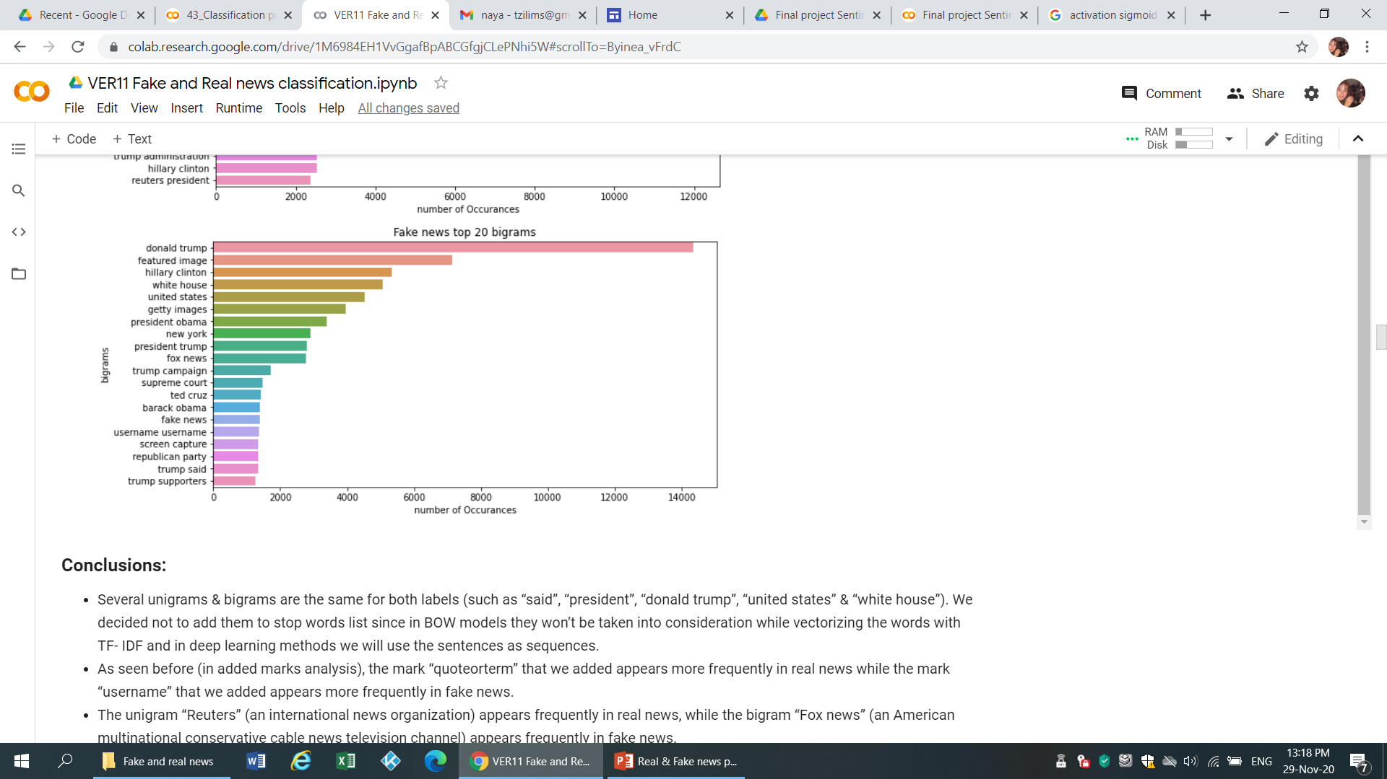
Unigrams and bigrams
Several unigrams & bigrams are the same for both labels (such as “said”, “president”, “trump”, “united states” & “white house”)
The mark “quoteorterm” appears more frequently in real news while the mark “username” appears more frequently in fake news
The unigram “Reuters” (an international news organization) appears frequently in real news, while the bigram “Fox news” (an American multinational conservative cable news television channel) appears frequently in fake news
The bigram “fake news” appears frequently in fake news
Notes:
ססיליה

Slide 10
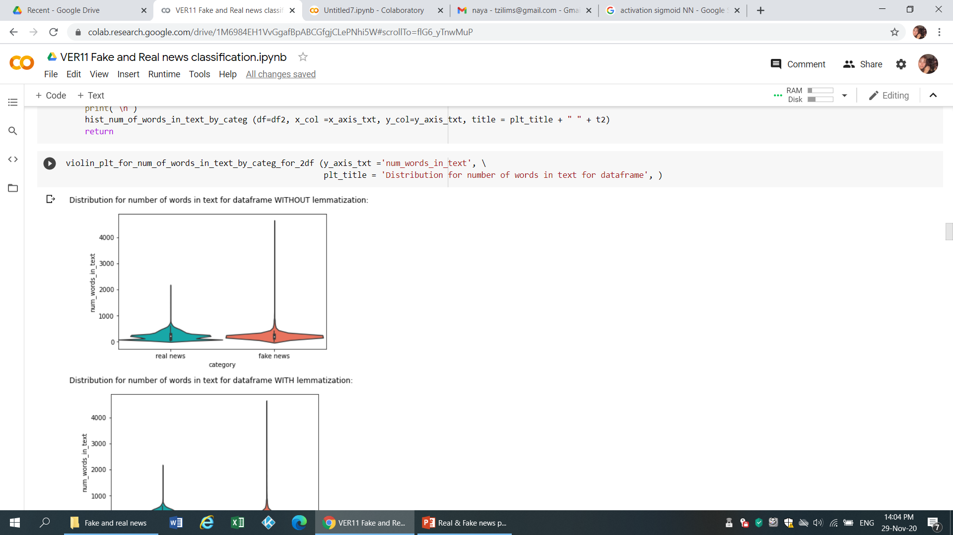
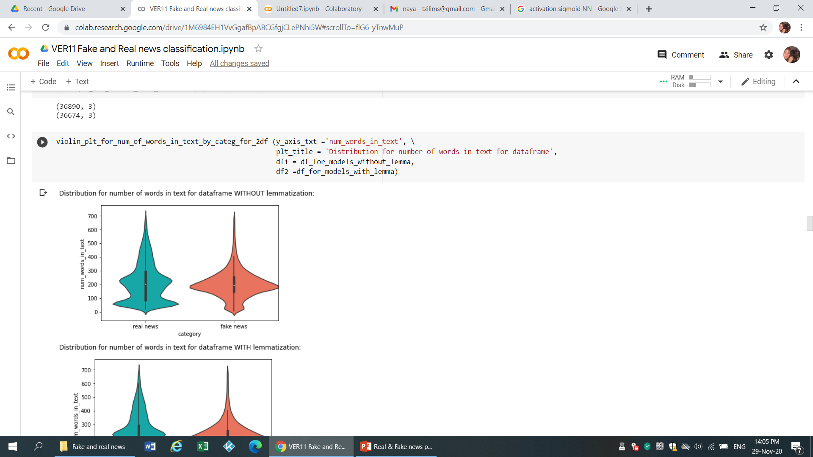
Number of words in text – outliers detection
Drop outliers - samples with over 700 words in text
Notes:
ססיליה

Slide 11
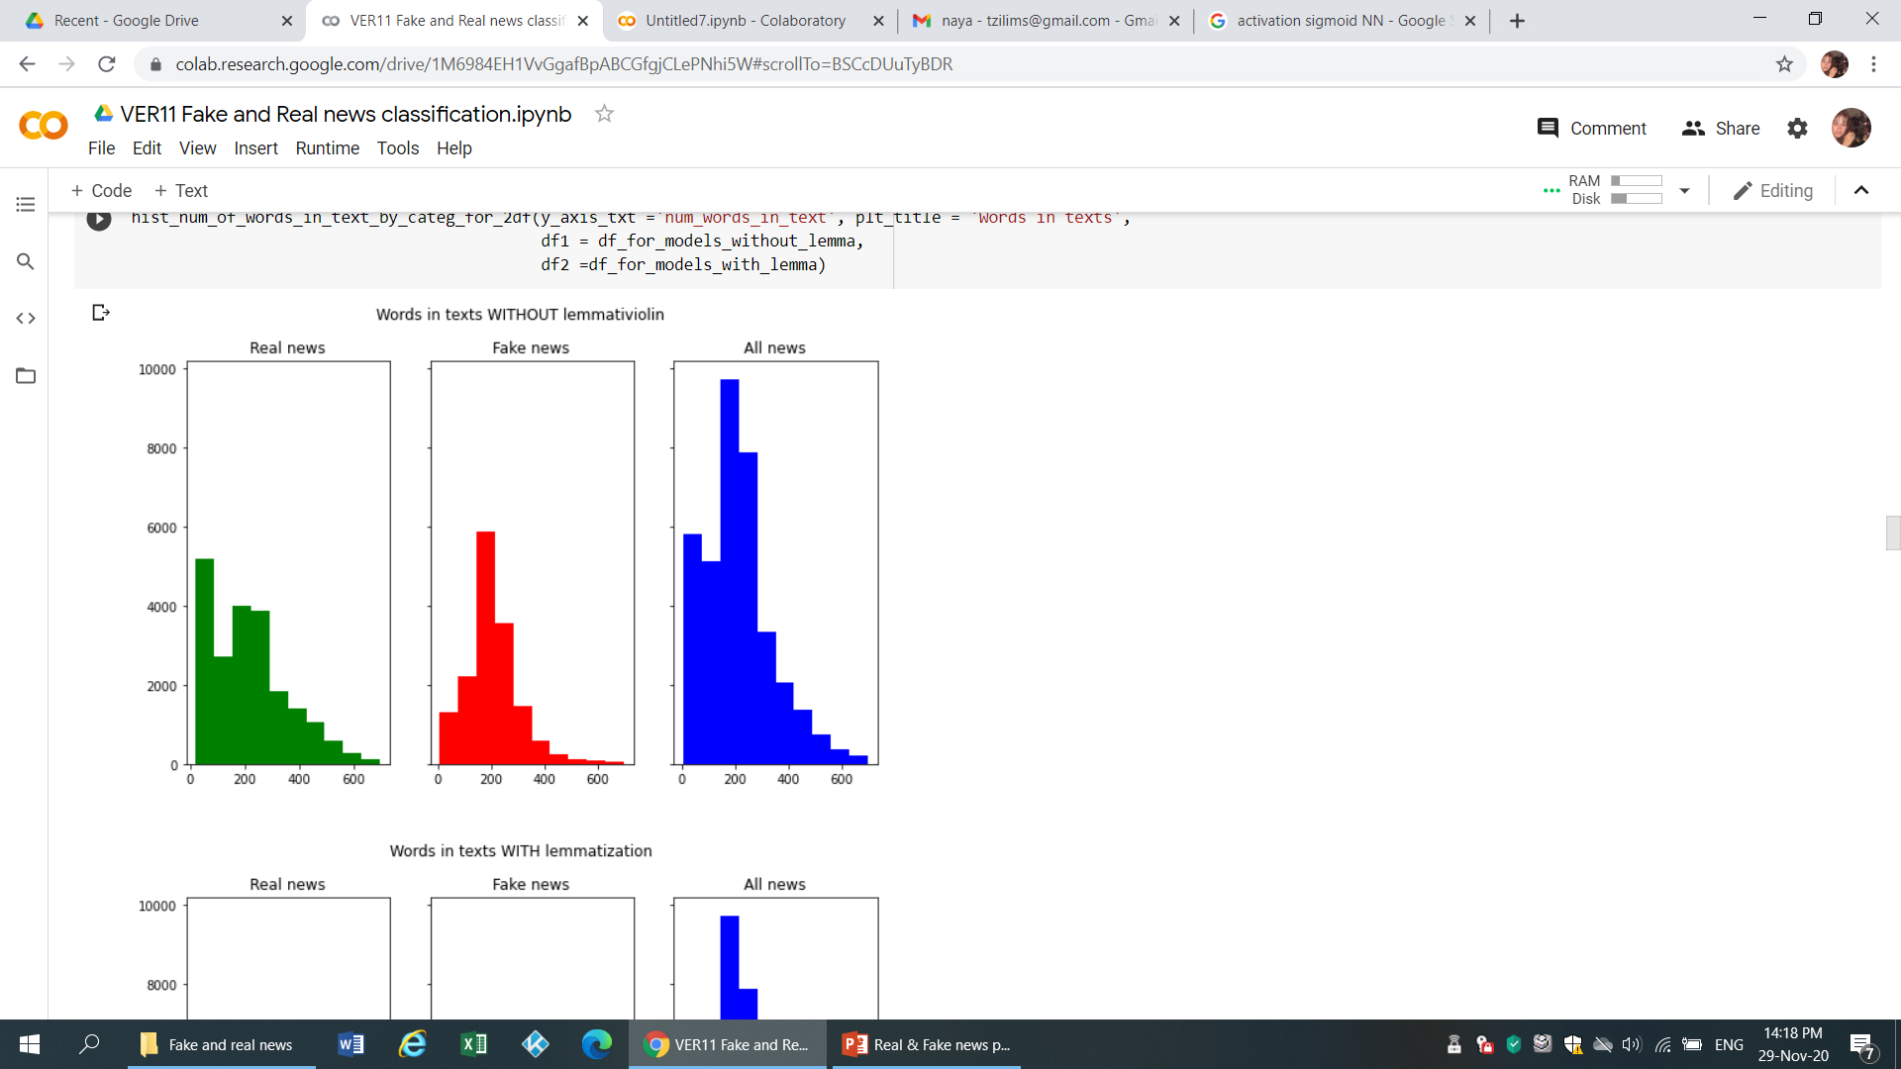
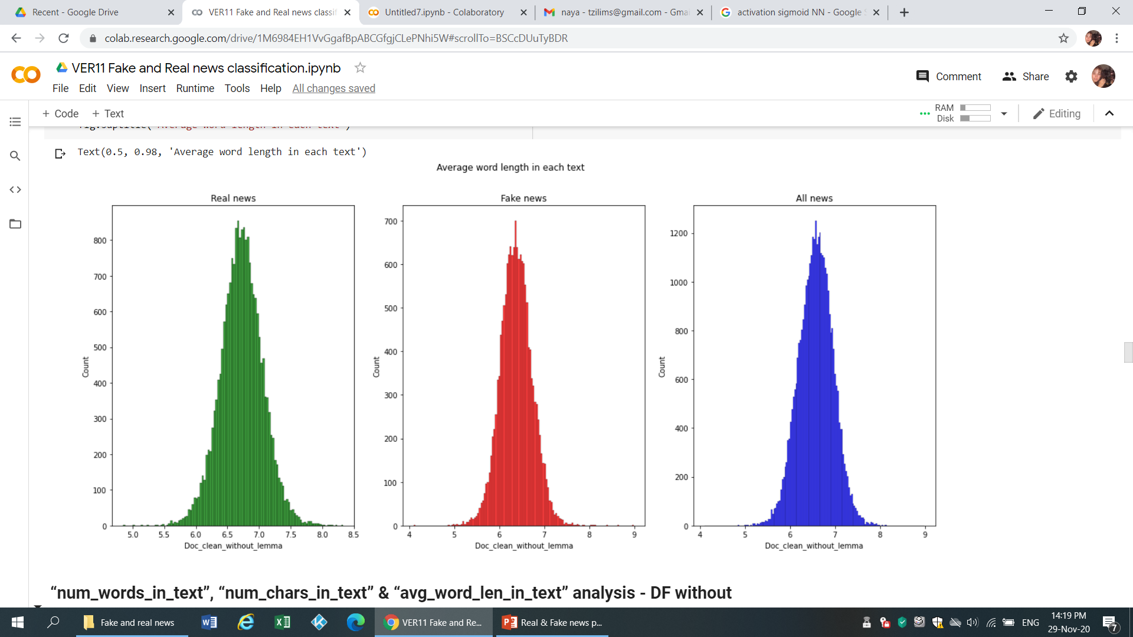
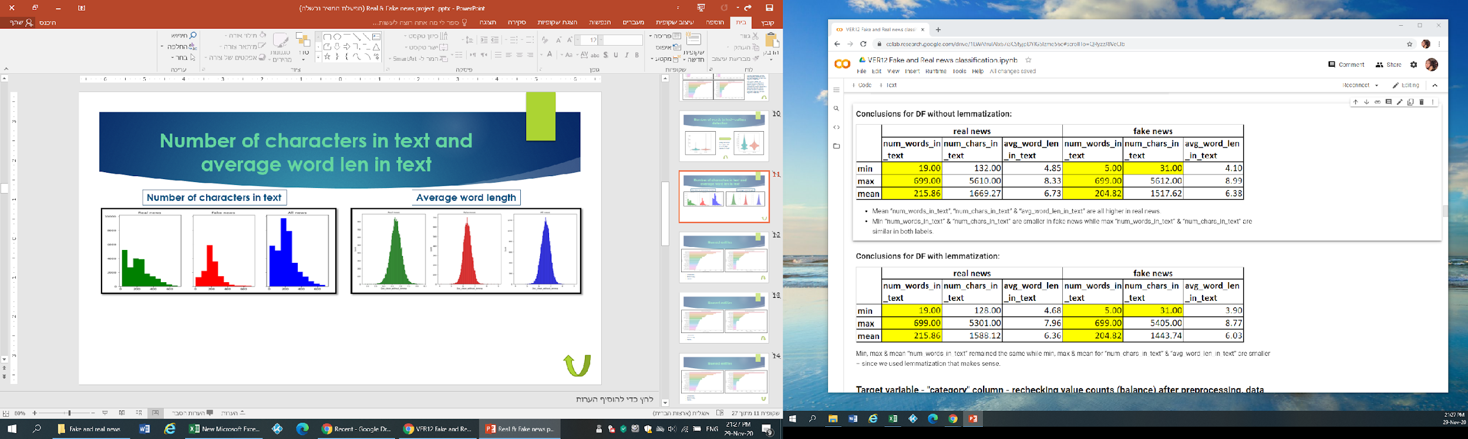
Number of characters in text and average word len in text
Number of characters in text
Average word length
Notes:
ססיליה

Slide 12
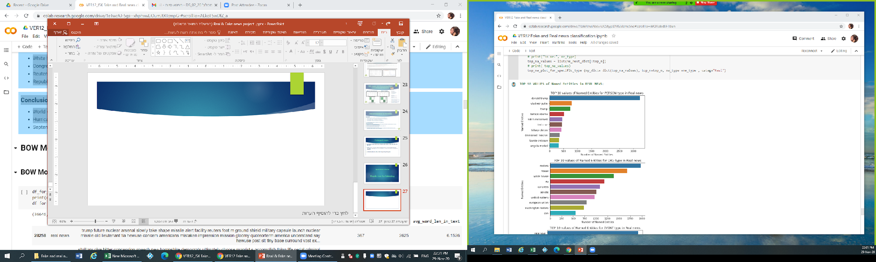
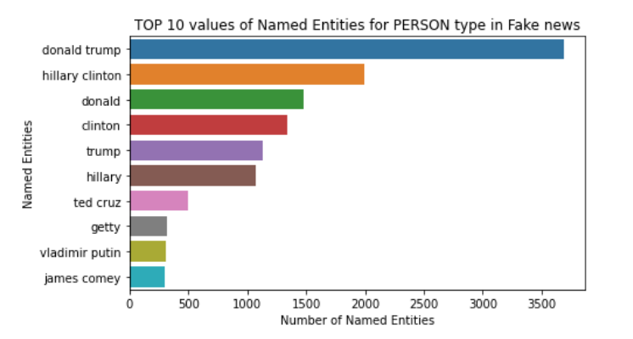
Named entities – PERSON (People, including fictional)
Donald Trump is most frequent in both real & fake news
Hillary Clinton is more frequent in fake news
Vladimir Putin is more frequent in real news
Notes:
אירנה

Slide 13
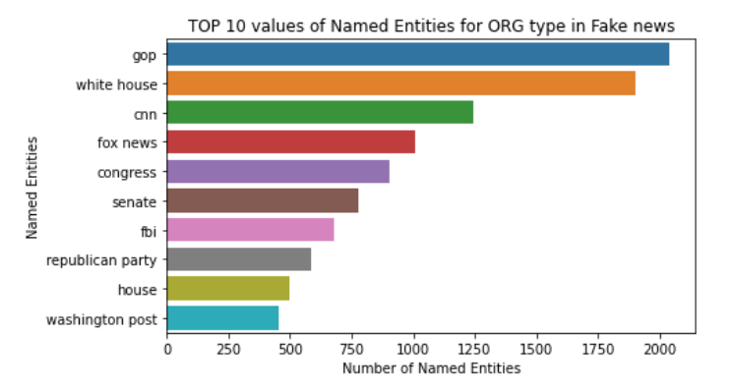
Named entities – ORG (Companies, agencies, institutions, etc.)
Reuters is frequent in real news while Fox news & Washington post are frequent in fake news
European union / EU are frequent in real news while Republican party / GOP & FBI are frequent in fake news
Notes:
אירנה

Slide 14
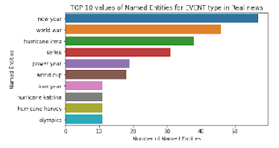
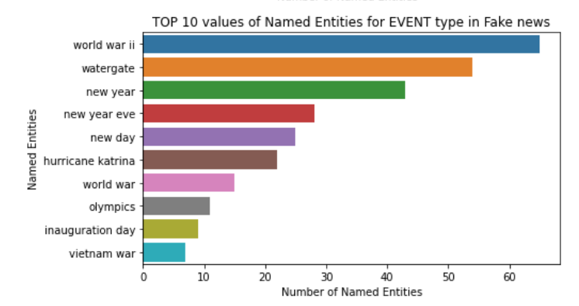
Named entities – EVENT (Named hurricanes, battles, wars, sports events, etc.)
Watergate is frequent in fake news
Hurricane Irma & Hurricane Harvey are frequent in real news while Hurricane Katrina is frequent in both fake & real news
Iran is frequent in real news
Word war is frequent in both fake & real news
Notes:
אירנה

Slide 15
Models
DF with lemmatization
DF without lemmatization
Split the data to train & test
Split the data to train & test
BOW models
Deep learning models
TF – IDF vectorizer
Cross validation
Grid search
Create sequence matrix
Max words
Max len
Logistic regression with lemmatization
Random forest with lemmatization
Logistic regression without lemmatization
Random forest without lemmatization
RNN with embedding & LSTM without lemmatization
RNN with glove embedding & LSTM without lemmatization
Notes:
ססיליה

Slide 16
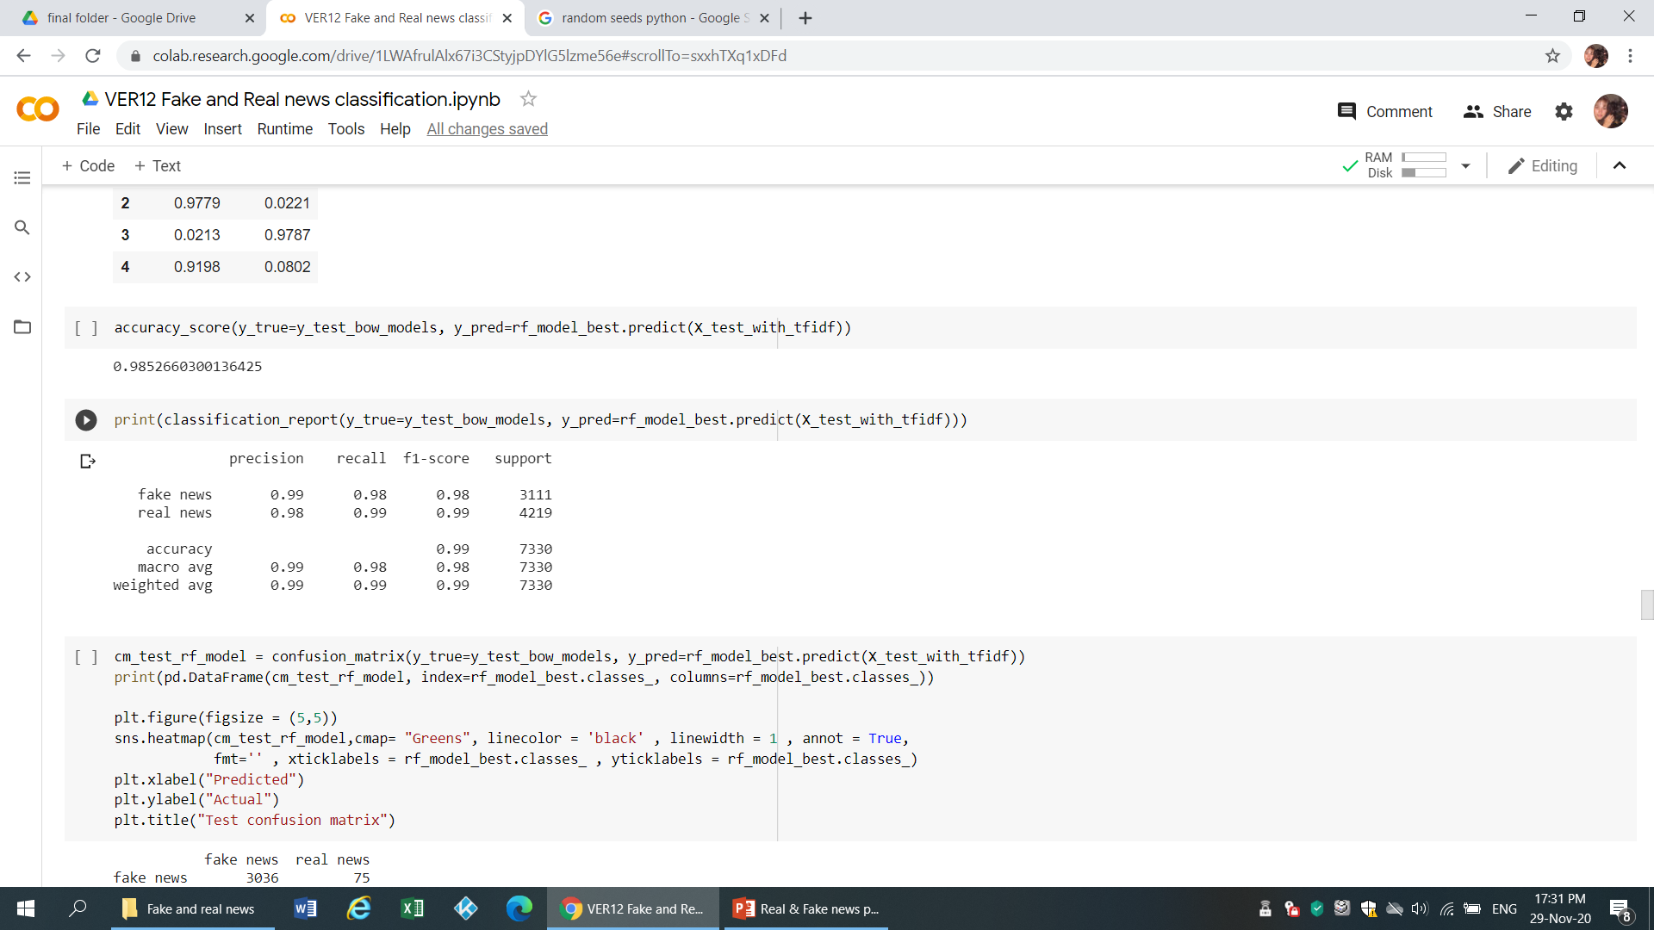

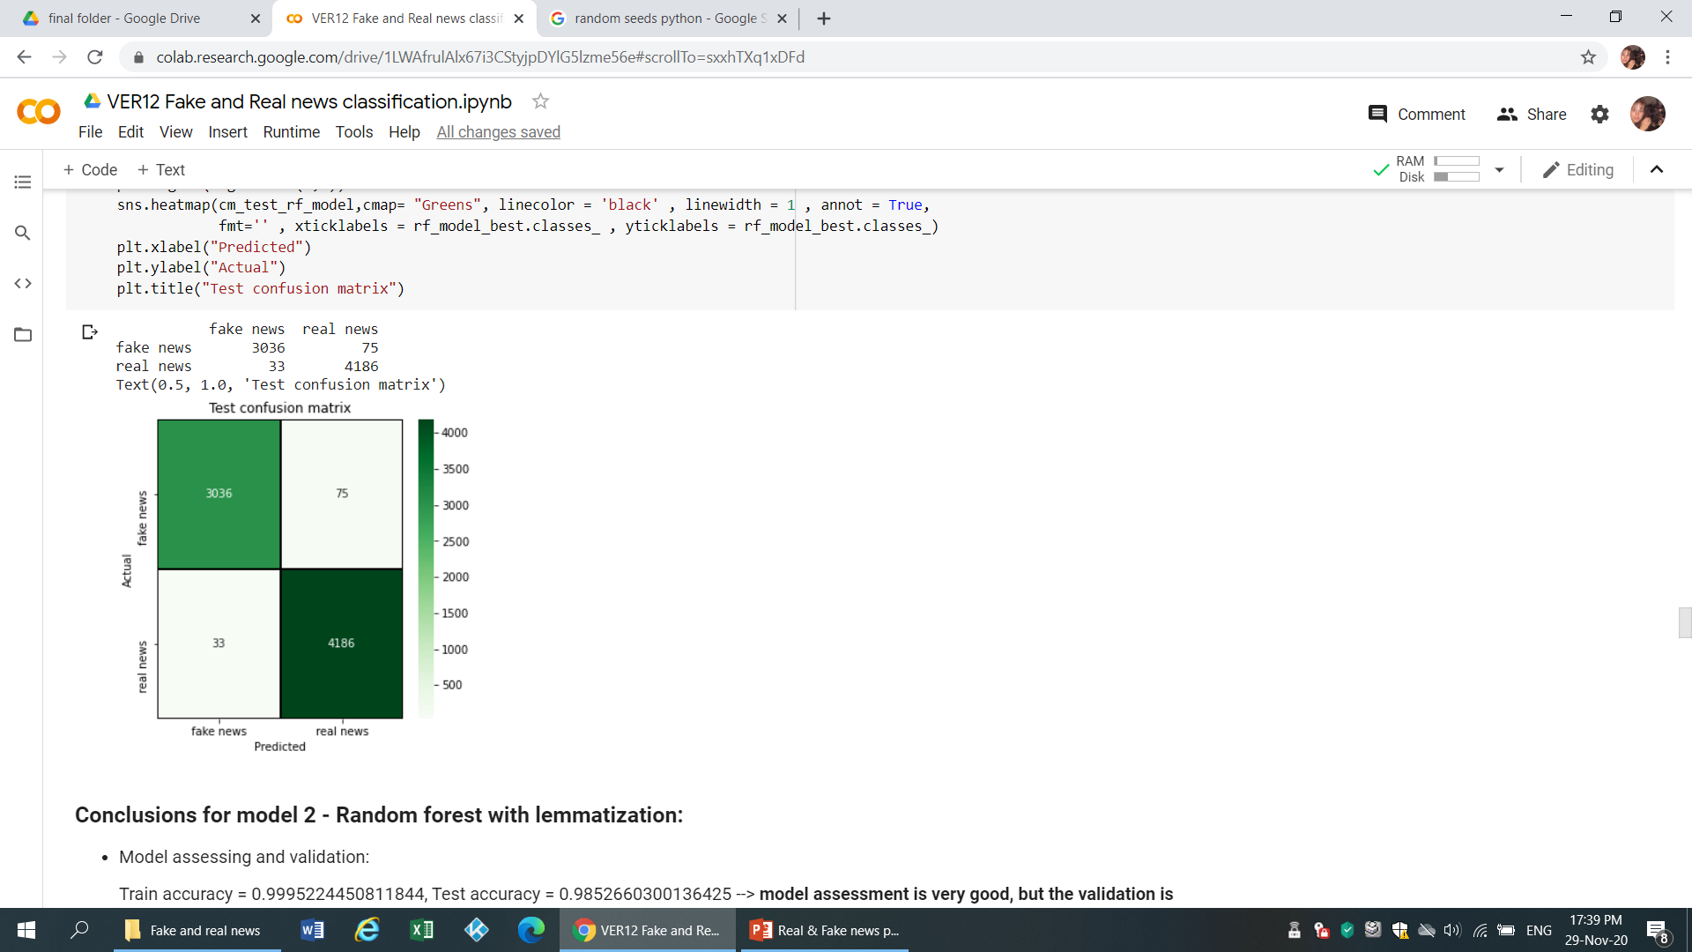
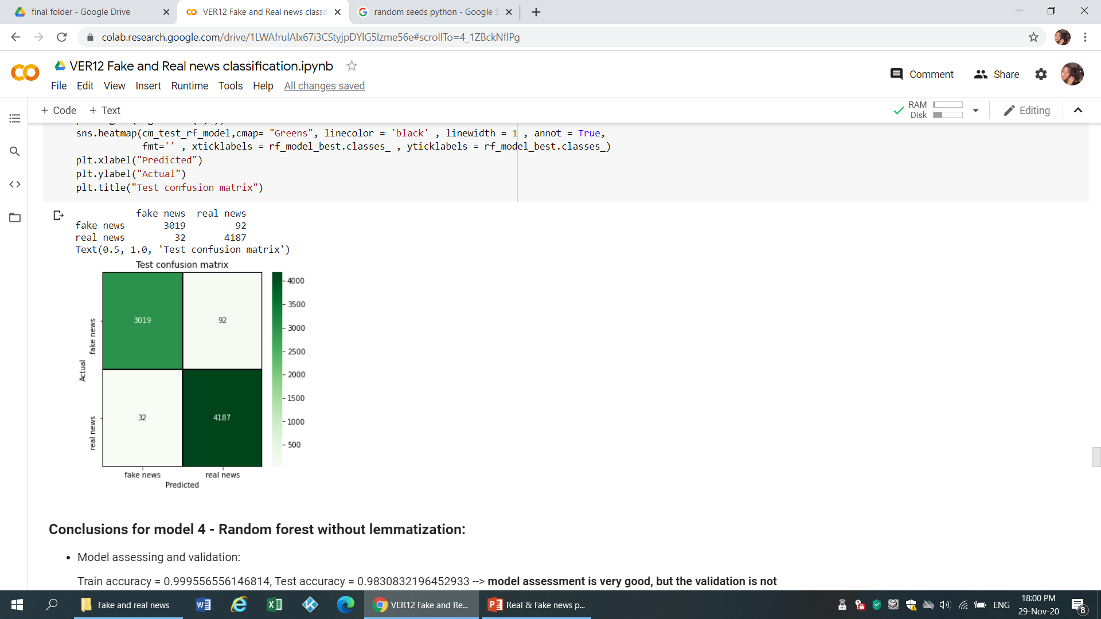
Random forest models
With lemmatization
Parameters:
min_samples_leaf = 2
n_estimators = 100
criterion = ‘entropy’
class_weights = ‘balanced’
With lemmatization:
Train accuracy = 0.9995224450811844
Test accuracy = 0.9852660300136425
Without lemmatization:
Train accuracy = 0.999556556146814
Test accuracy = 0.9830832196452933
Without lemmatization
Notes:
אירנה
min_samples_leaf int or float, default=1 - The minimum number of samples required to be at a leaf node.
n_estimators int, default=100 - The number of trees in the forest.
Criterion {“gini”, “entropy”}, default=”gini” - The function to measure the quality of a split. Supported criteria are “gini” for the Gini impurity and “entropy” for the information gain. Note: this parameter is tree-specific.
class_weight {“balanced”, “balanced_subsample”}, dict or list of dicts, default=None - Weights associated with classes in the form {class_label: weight}. If not given, all classes are supposed to have weight one. For multi-output problems, a list of dicts can be provided in the same order as the columns of y.

Slide 17
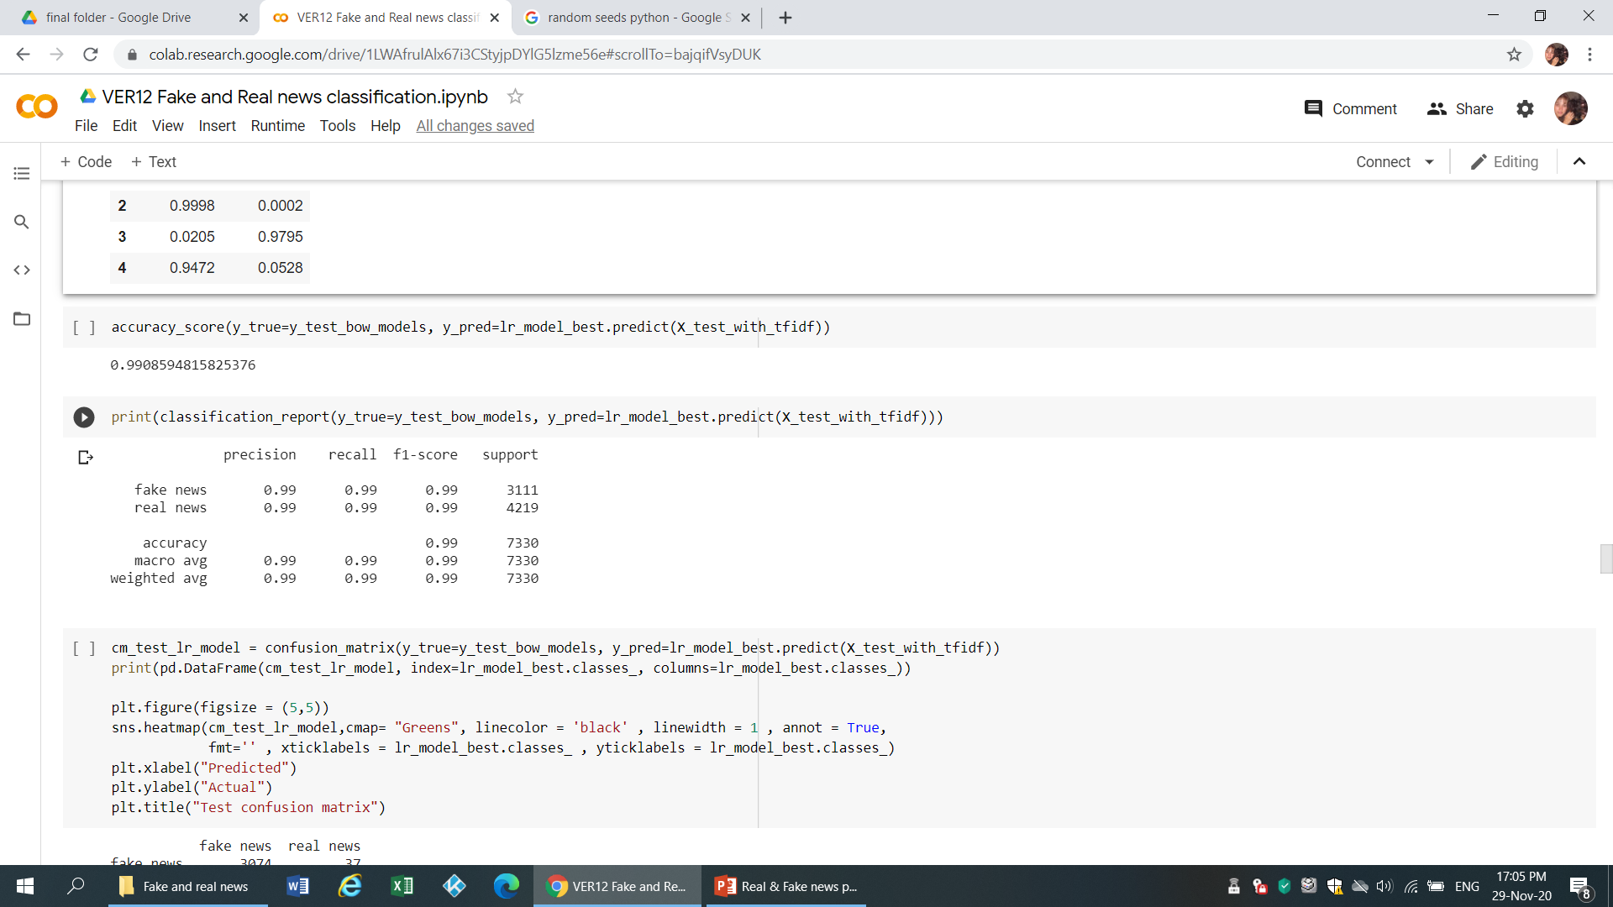
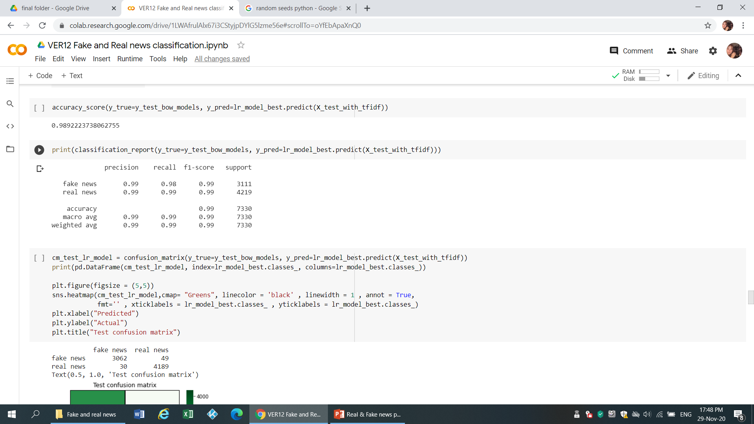
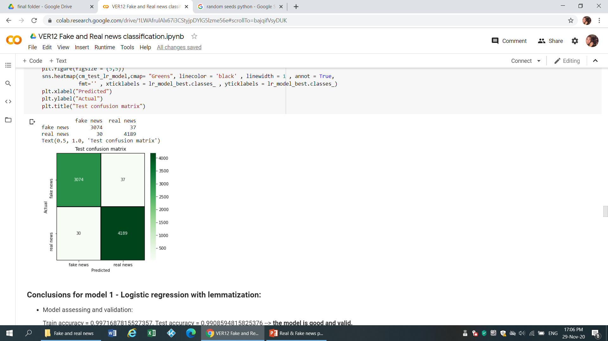
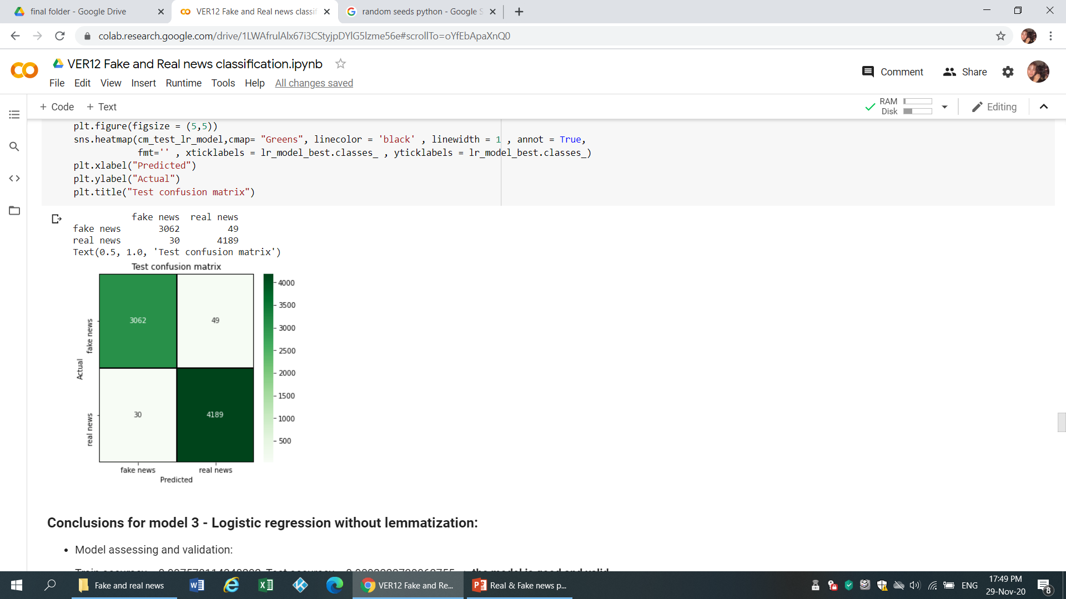
Logistic regression models
With lemmatization
Without lemmatization
Parameters:
max_iter = 200
class_weights = ‘balanced’
C = 4
With lemmatization:
Train accuracy = 0.9971687815527357
Test accuracy = 0.9908594815825376
Without lemmatization:
Train accuracy = 0.997578114340292
Test accuracy = 0.9892223738062755
Notes:
אירנה
max_iter int, default=100 - Maximum number of iterations taken for the solvers to converge.
C float, default=1.0 Inverse of regularization strength; must be a positive float. Like in support vector machines, smaller values specify stronger regularization.
class_weight dict or ‘balanced’, default=None - Weights associated with classes in the form {class_label: weight}. If not given, all classes are supposed to have weight one.

Slide 18
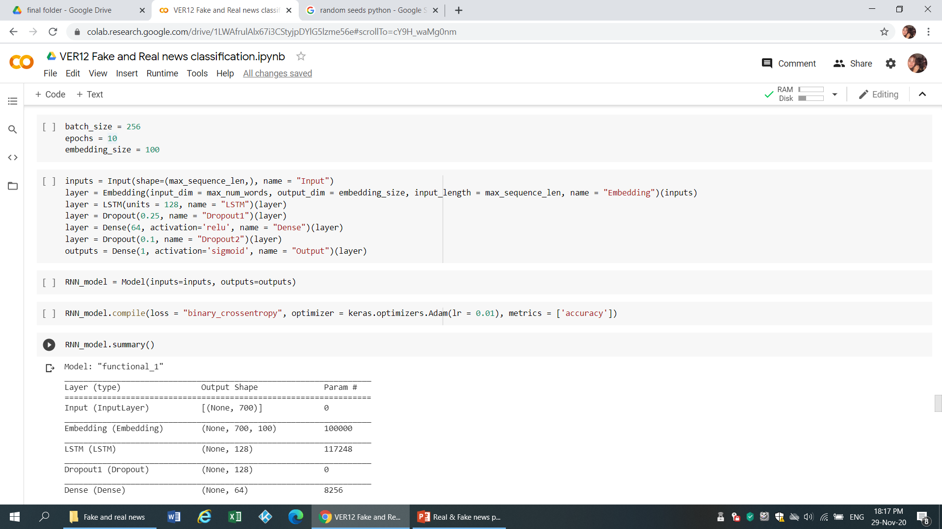
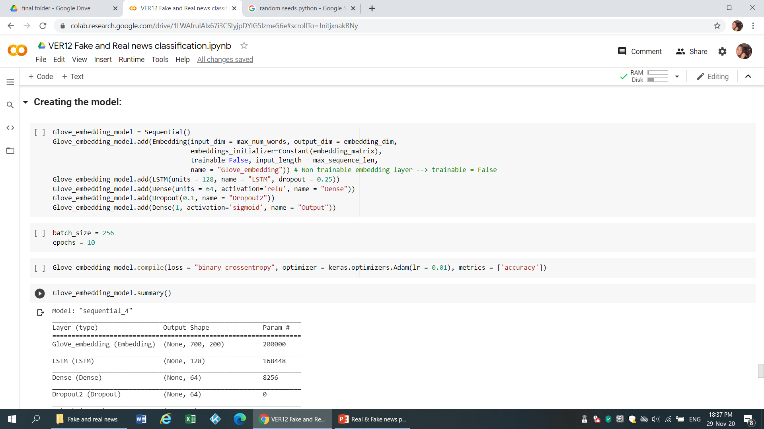
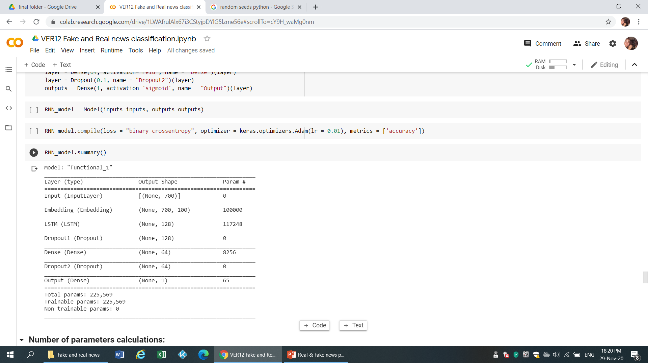
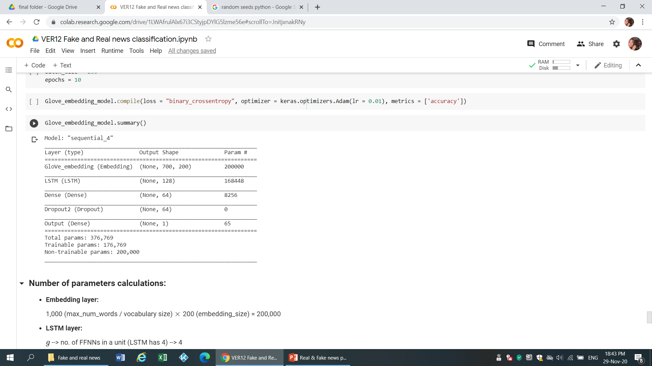
RNN models with LSTM & embedding
With 100D embedding
With Glove 200D embedding
Notes:
ססיליה

Slide 19
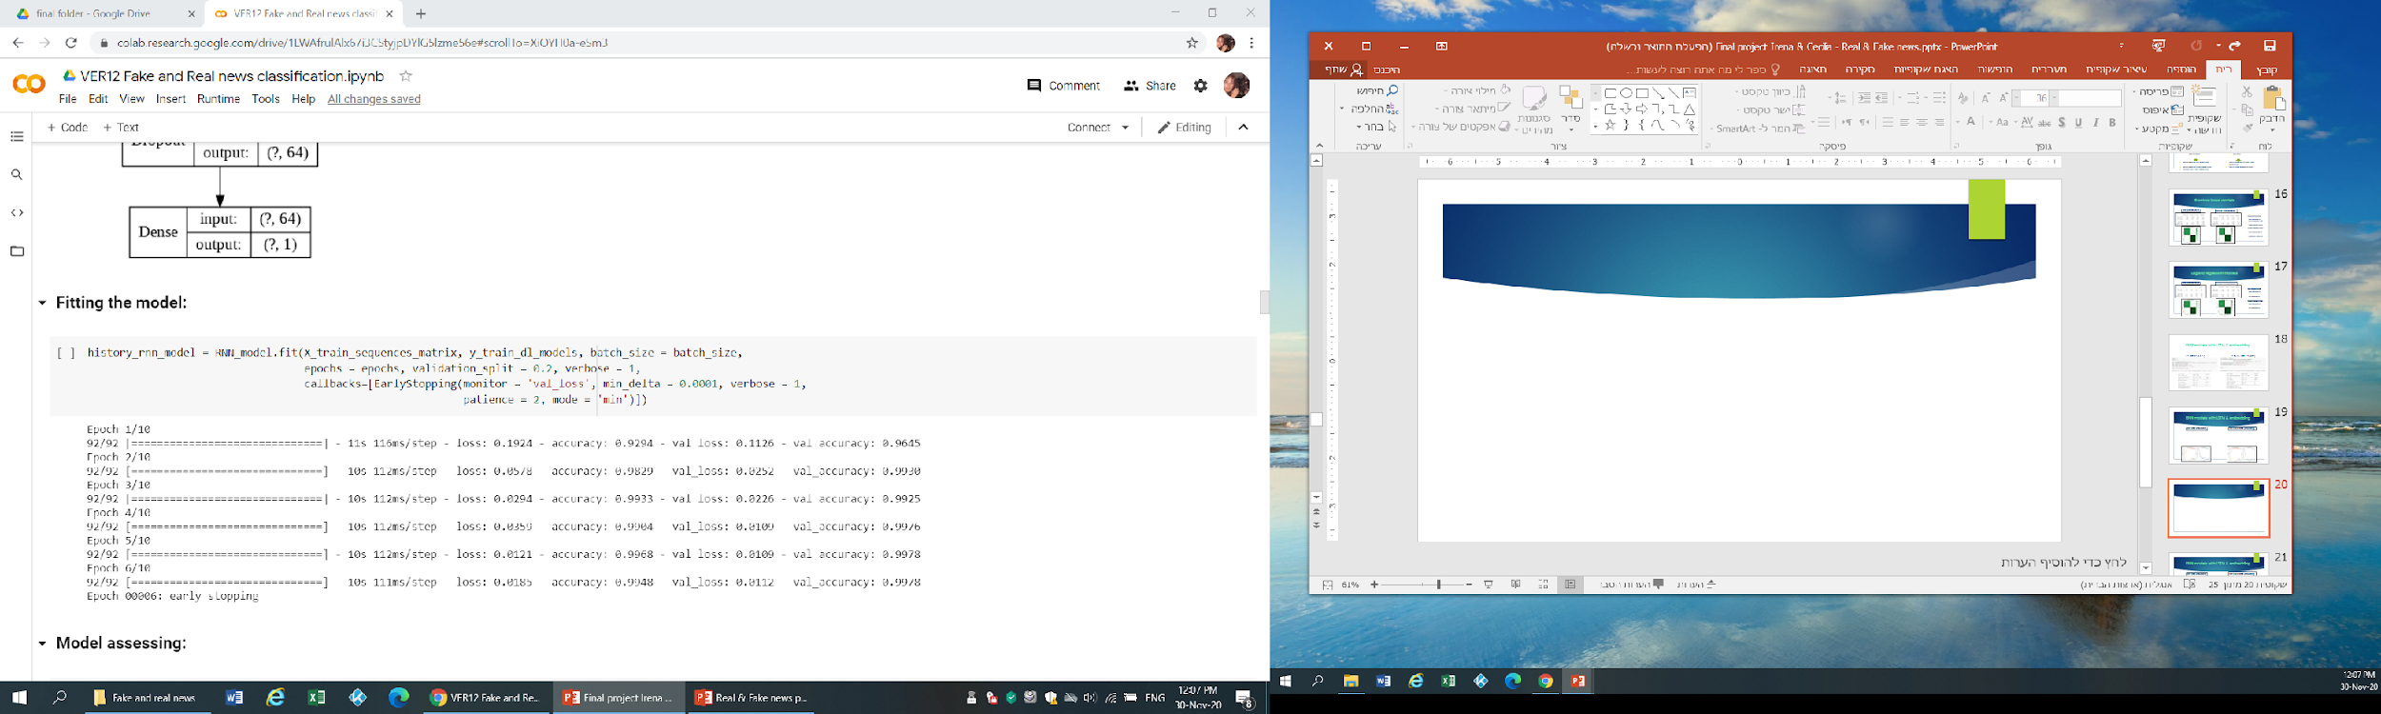
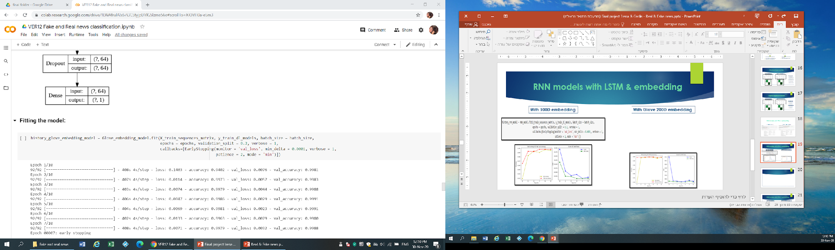
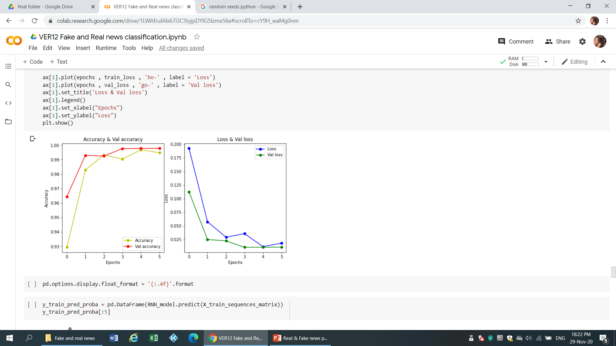
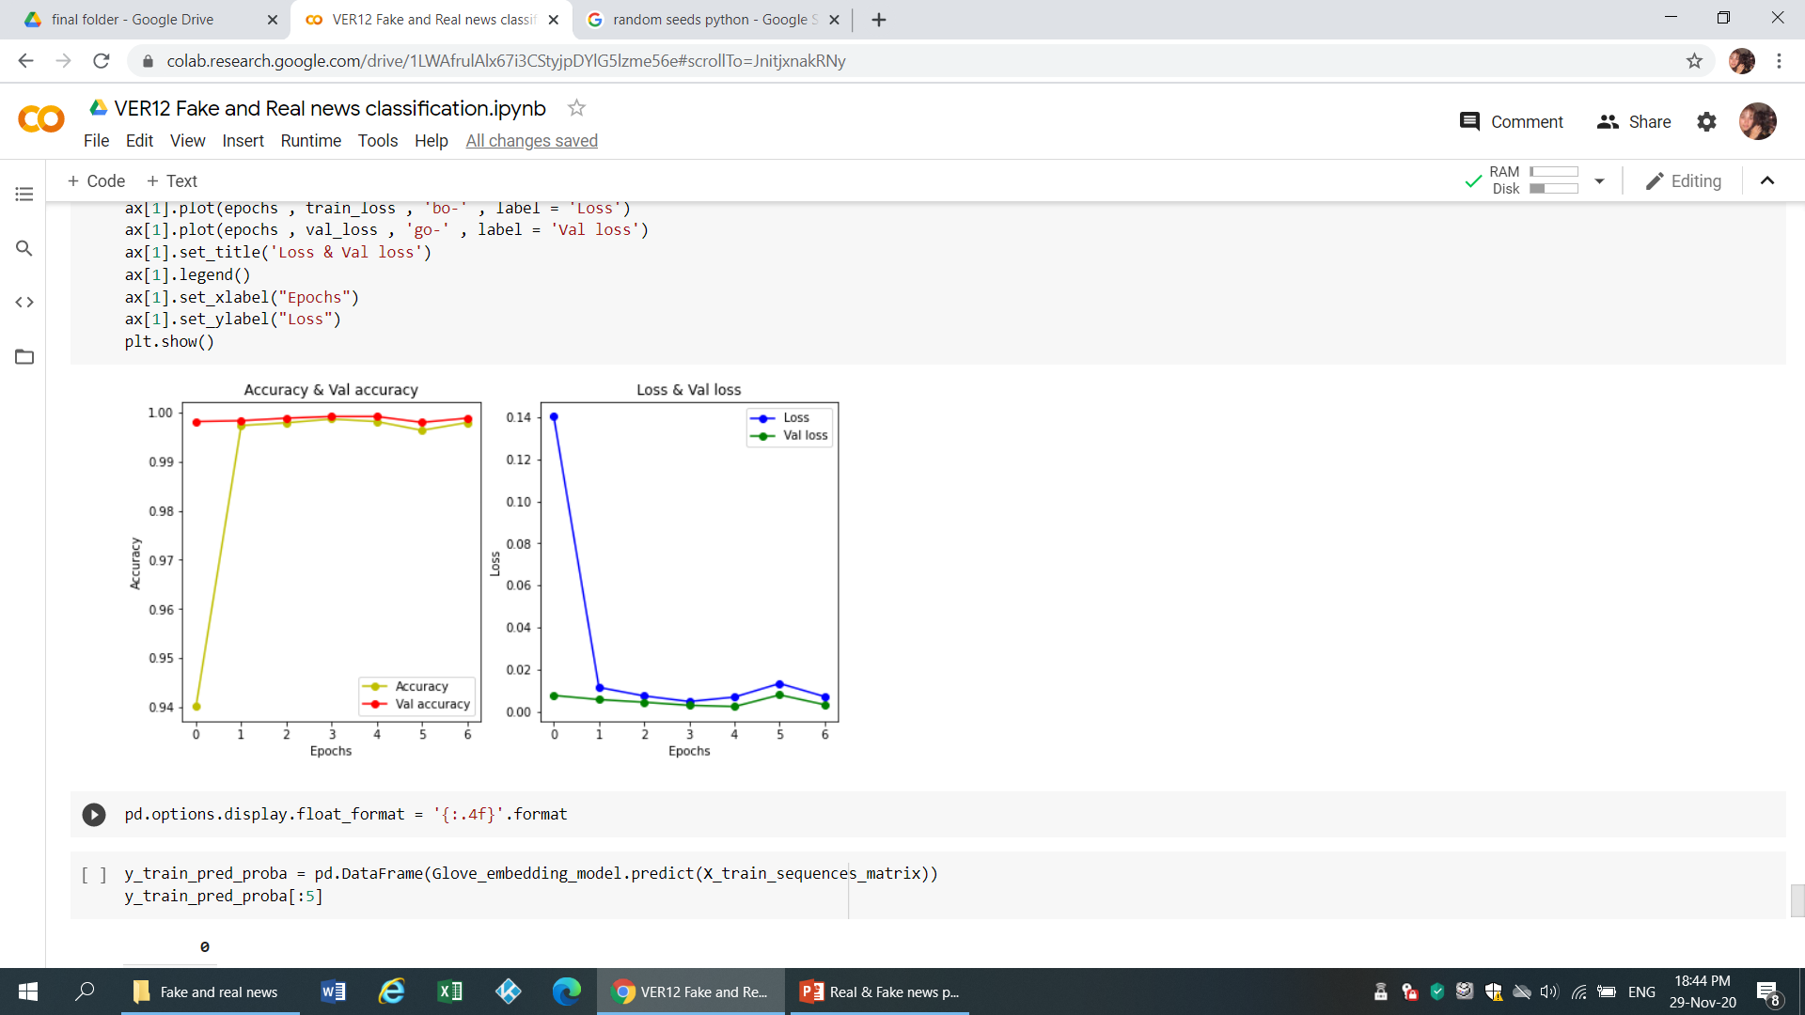
RNN models with LSTM & embedding
With 100D embedding
With Glove 200D embedding
Notes:
ססיליה

Slide 20
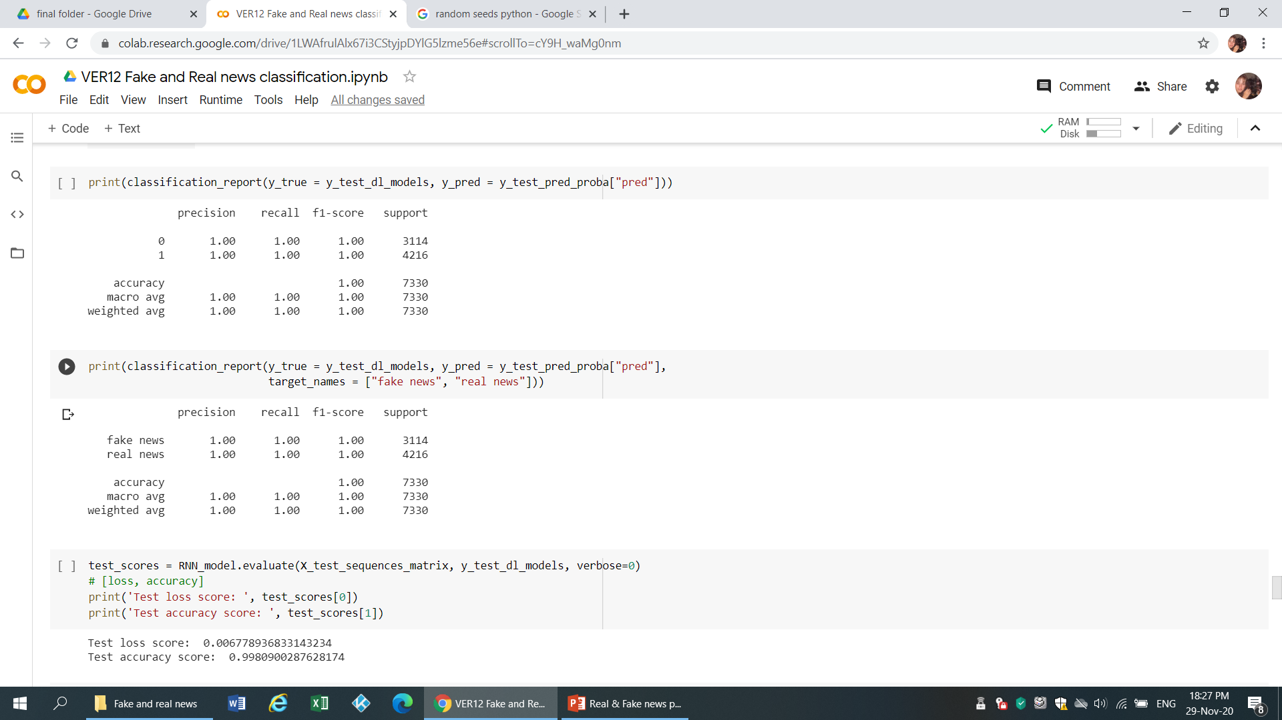
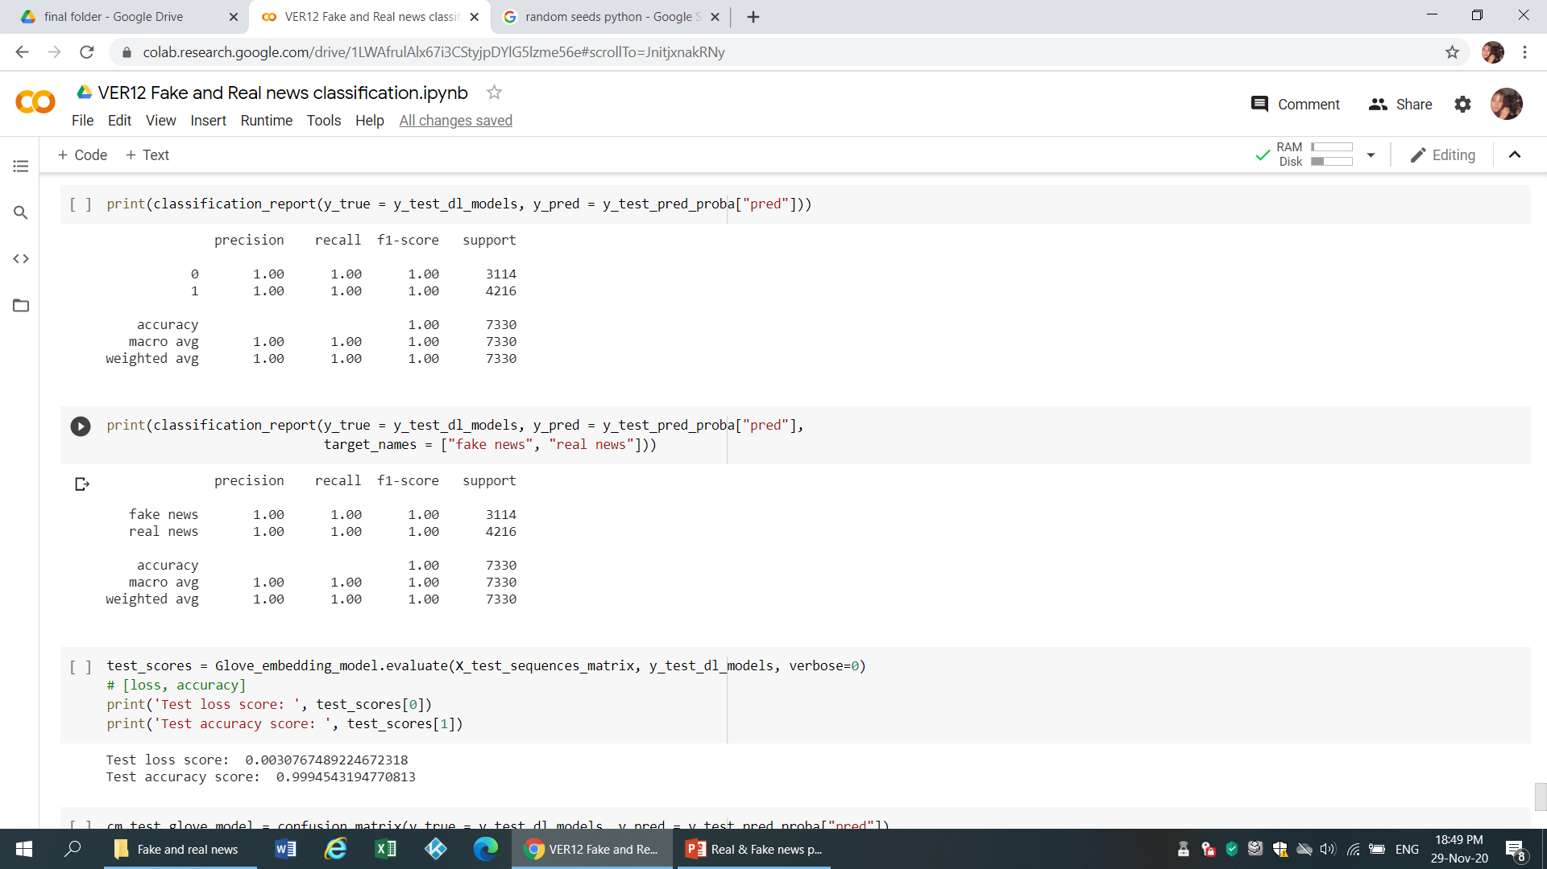

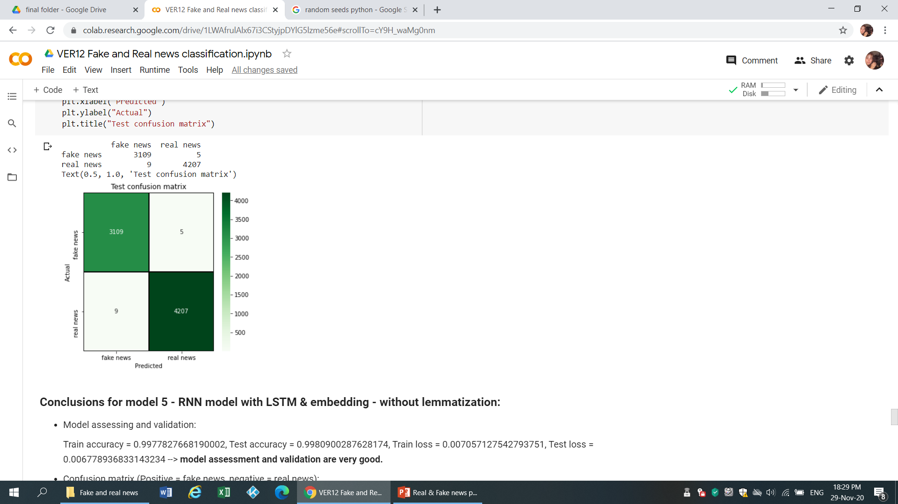
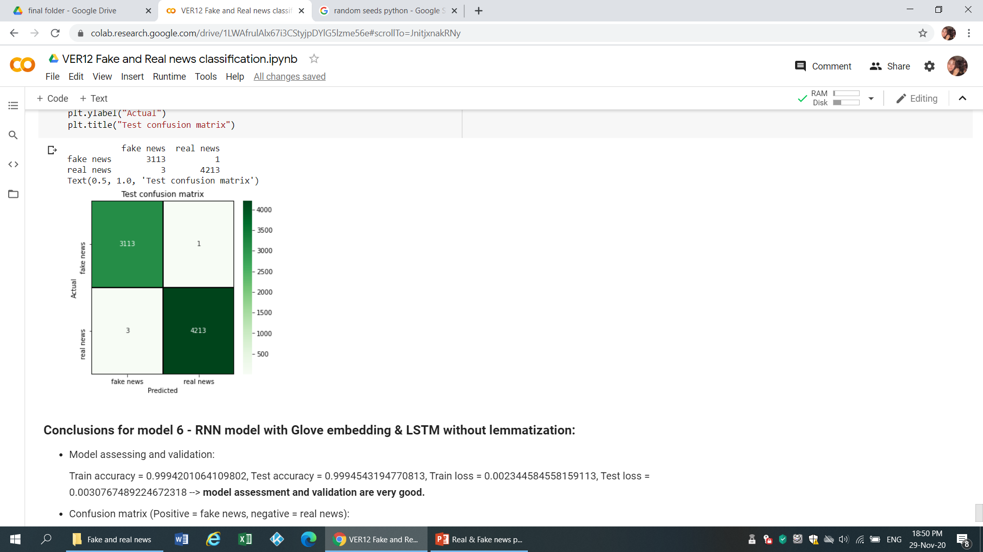
RNN models with LSTM & embedding (without lemmatization)
With 100D embedding
With Glove 200D embedding
With 100D embedding:
Train accuracy = 0.99778277
Test accuracy = 0.99809003
Train loss = 0.00705713
Test loss = 0.00677894
With Glove 200D embedding:
Train accuracy = 0.99942011
Test accuracy = 0.99945432
Train loss = 0.0023445846
Test loss = 0.00307675
Notes:
ססיליה

Slide 21
Final conclusions for all the models
Models rating:
Best model --> model 6 - RNN model with Glove embedding & LSTM without lemmatization.
Second best model --> model 5 - RNN model with LSTM & embedding - without lemmatization.
Third place model --> model 1 - Logistic regression with lemmatization.
Fourth place model --> model 3 - Logistic regression without lemmatization.
Fifth place model --> model 2 - Random forest with lemmatization.
Last (sixth) place model --> model 4 - Random forest without lemmatization.
Models conclusions by type:
Deep learning models make the best predictions; Logistic regression models are second best & Random forest models are in last place.
BOW Models with / without lemmatization conclusions:
Both Logistic regression models & Random forest models are better with lemmatization.
BOW Models VS. Deep Learning Modes conclusions:
BOW models had better results when using less frequent words from train data vocabulary while Deep learning models had better results when using most frequent words from train data vocabulary.
Notes:
ססיליה

Slide 22
Challenges
NLP – many different techniques, approaches and libraries, different EDA than other data sets.
spaCy VS. NLTK – different ways of implementations for the same tasks & different running time. spaCy provides extra information, but needs much more running time & resources.
Limited resources (RAM, GPU) – crash / long running time/ pickle.
Notes:
ססיליה

Slide 23

Thank you for listening
Alon Tam

